Slide 1

NLP
Image Caption Generation Using AI

Slide 2


TEAM MEMBERS
Omar Ayman Allam
2201061
Taha Ayman Taha
2200061
Mohammed Osama
2201255
Abdalrhman Akram
2201061

Slide 3
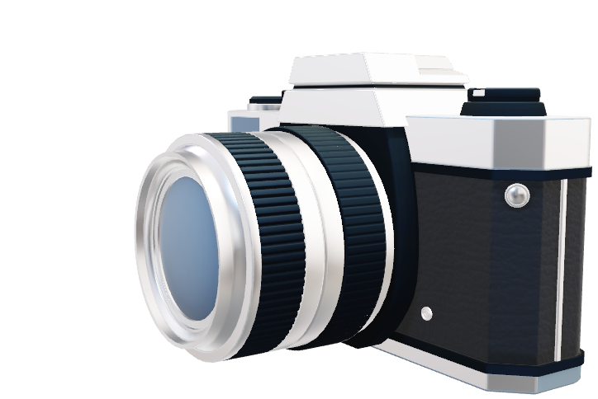
Introduction
Build a system to automatically generate captions for images using AI
Importance
Practical application of AI in image processing and natural language processing (NLP)

Slide 4
Problems
Manually describing images is time-consuming.
Accurate automatic descriptions are challenging.
Solutions
Use VGG16 to extract image features.
Use LSTM model to generate captions.
Translate captions to Arabic.

Slide 5
Architecture
Input: User uploads an image.
Feature Extraction: VGG16 extracts features (4096 dimensions).
Caption Generation: LSTM model generates captions.
Output: Display caption (and translated version, if enabled).

Slide 6
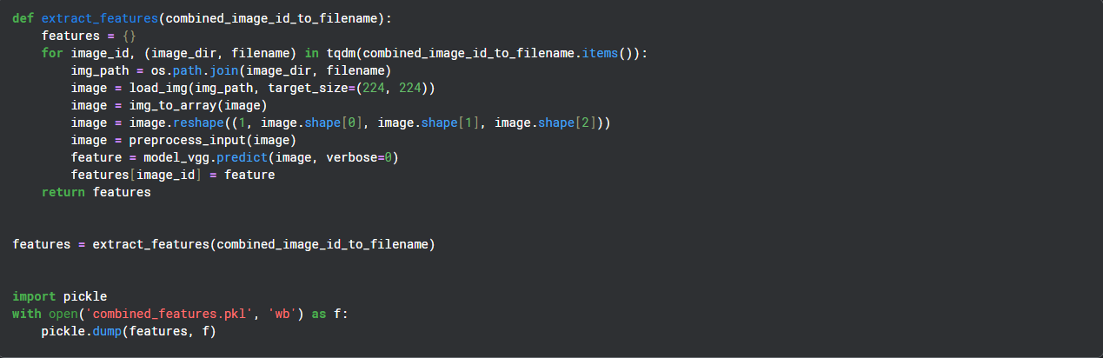
Algorithms Used
CNN-LSTM Greedy:
VGG16 extracts features, LSTM generates captions using greedy search (picks most probable word at each step).
CNN-LSTM Beam:
Uses beam search to explore multiple caption possibilities (e.g., beam width = 3) for better accuracy.
CNN-LSTM Attention:
Adds attention mechanism to focus on specific image regions while generating each word.
Translation:
Optional translation of captions to Arabic using googletrans (not fully implemented due to dependency issues).

Slide 7
Technologies Used
Feature Extraction:
VGG16 (pre-trained on ImageNet, ~528 MB weights).

Slide 8
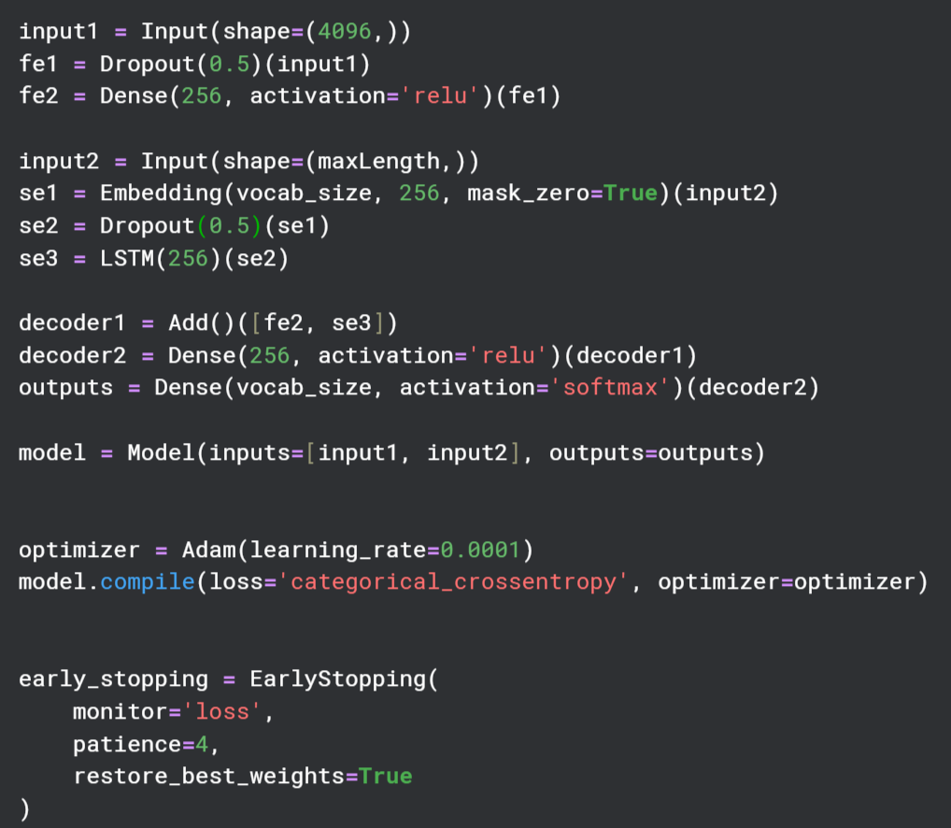
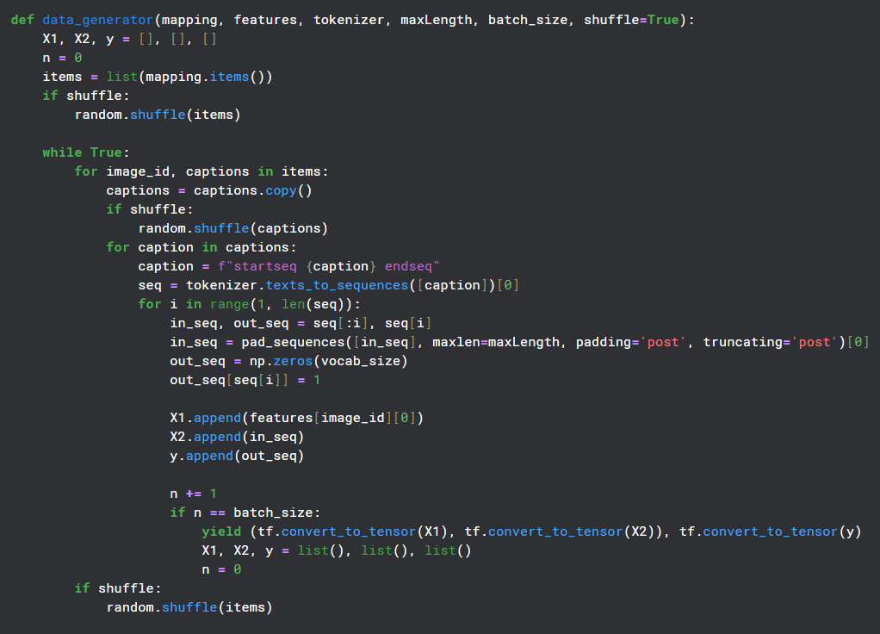
Technologies Used
Train model
Data: Dataset with images and captions (e.g., Flickr8k and mini coco).

Slide 9
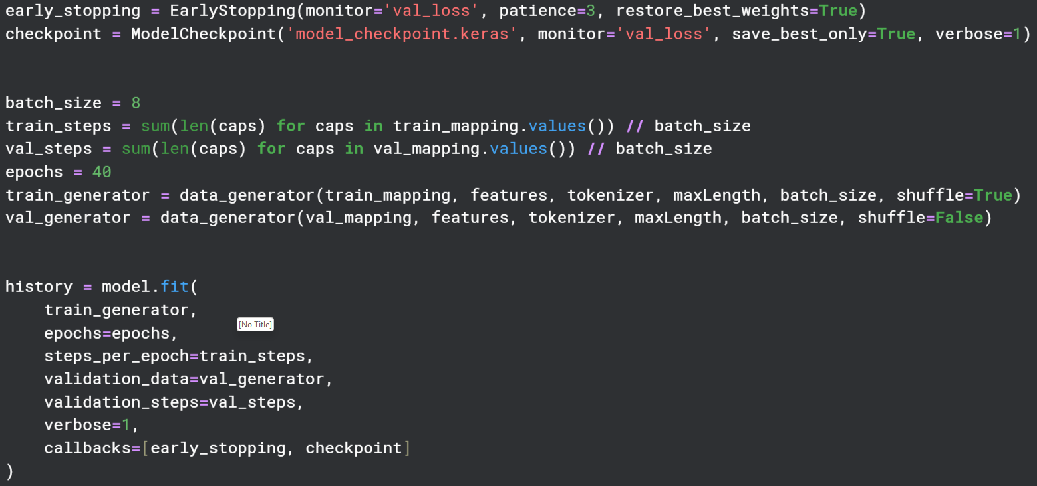
Technologies Used
Train model

Slide 10
Technologies Used

